Slide 1
Virtual Sports Week Challenge
Blindfold Balance | Partner Plank | Book Balance | Bunny Hops | Sit Down, Stand Up
Plank | Not quite an egg and spoon race | Graceful roll onto your back | Skipping | How far can you jump
Taekwando Challenge | Tennis Racket Bounce | Throw and clap | Washing Line Challenge

Slide 2
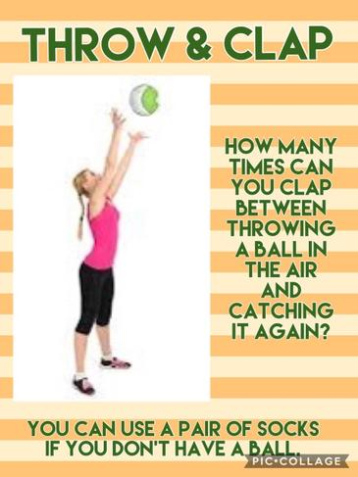

Slide 3
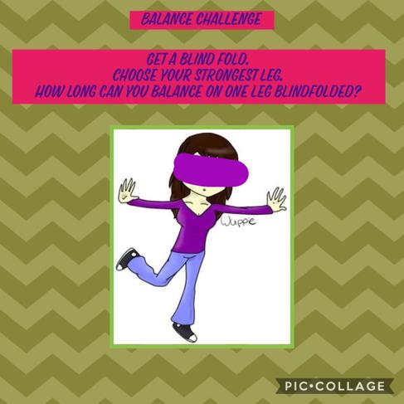

Slide 4
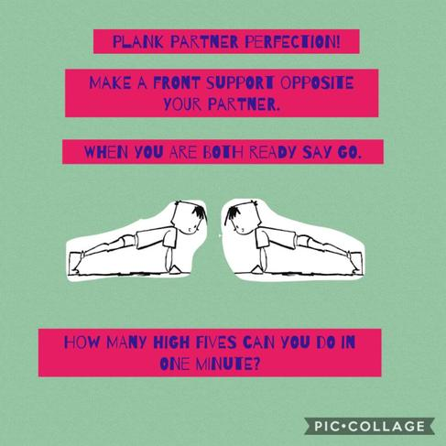

Slide 6
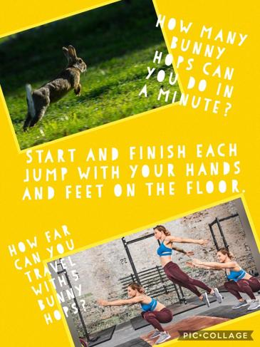

Slide 7
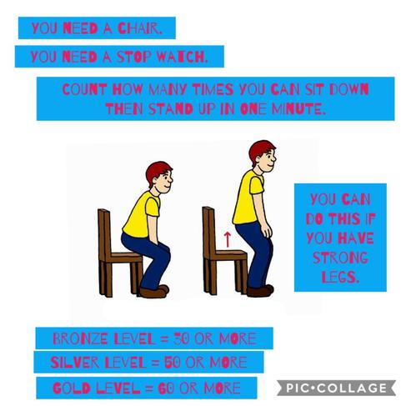

Slide 8
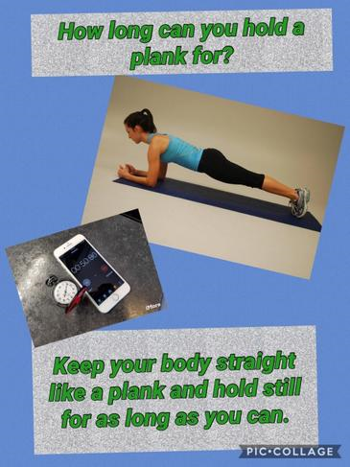

Slide 10
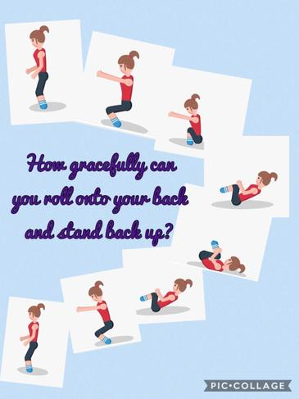

Slide 11
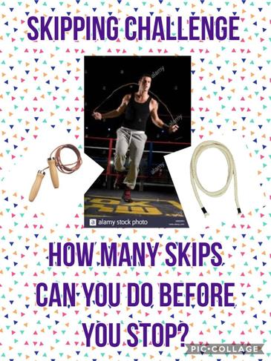

Slide 12
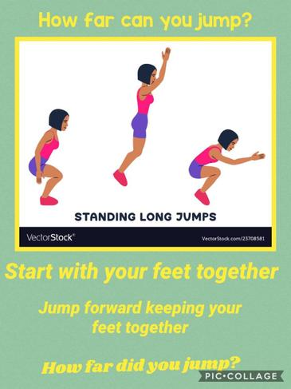

Slide 14
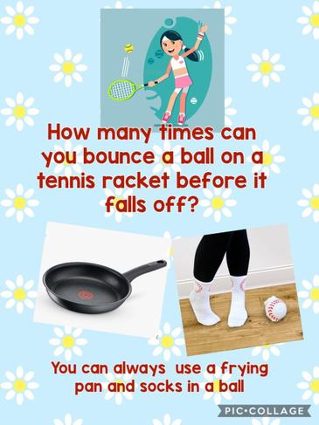

Slide 15
